Slide 1

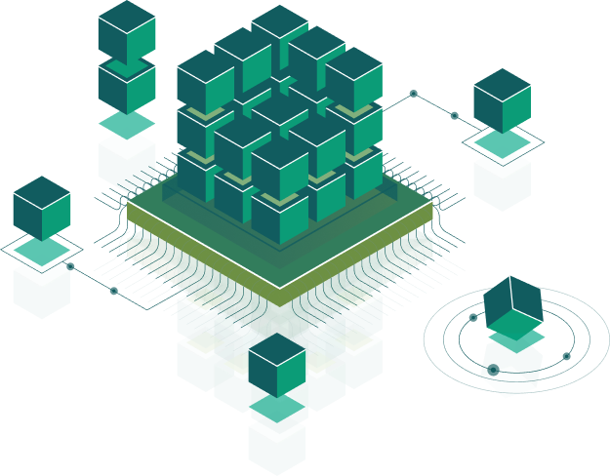
App distribution Android
Speaker:
Valerii Kotsulym

Slide 2

Publish your app
Publishing is the general process that makes your Android applications available to users. When you publish an Android application you perform two main tasks:
You prepare the application for release.
During the preparation step you build a release version of your application, which users can download and install on their Android-powered devices.
You release the application to users.
During the release step you publicize, sell, and distribute the release version of your application to users.

Slide 3
The Google Play Developer Console
Releasing your application on Google Play is a simple process that involves three basic steps:
Preparing promotional materials - promotional materials for your application, such as screenshots, videos, graphics, and promotional text.
Configuring options and uploading assets - choose the countries you want to reach, the listing languages you want to use, and the price you want to charge in each country. You can also configure listing details such as the application type, category, and content rating.
Publishing the release version of your application - if you are satisfied that your publishing settings are correctly configured and your uploaded application is ready to be released to the public, you can simply click Publish in the Play Console and within minutes your application will be live and available for download around the world.

Slide 4
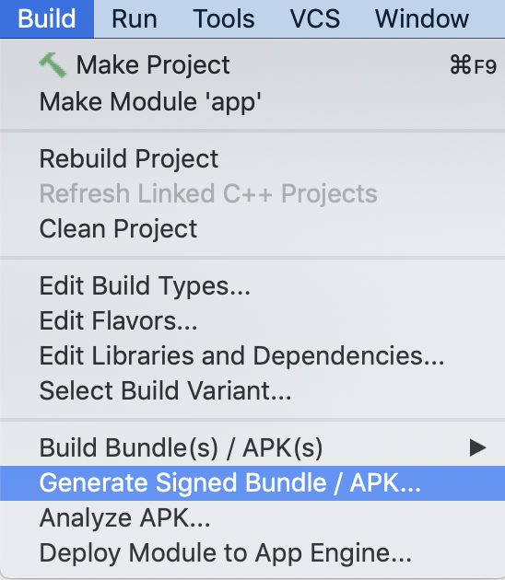
Creating a Signed APK
Android requires that APKs are digitally signed with a certificate before they can be installed. The certificate is used to identify the author of the app.
A signed APK can be generated manually from command line or in Android Studio.

Slide 5
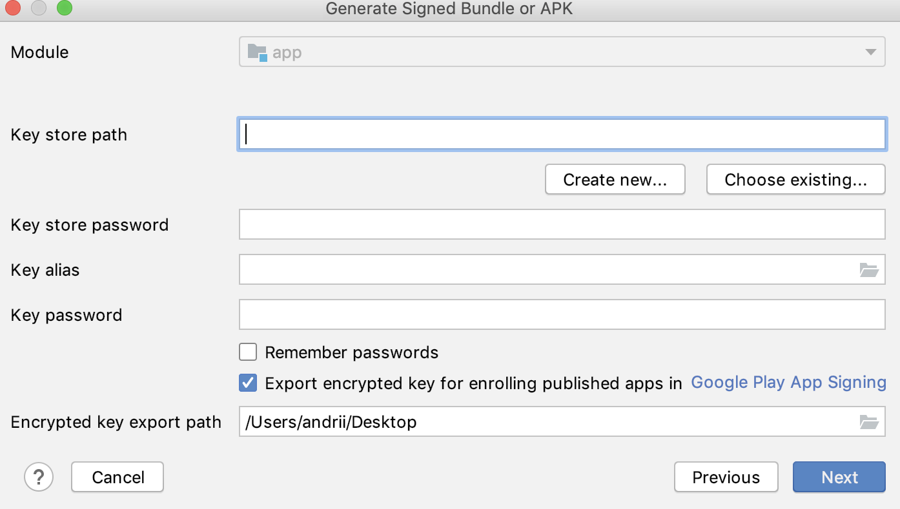
Creating a Signed APK

Slide 6
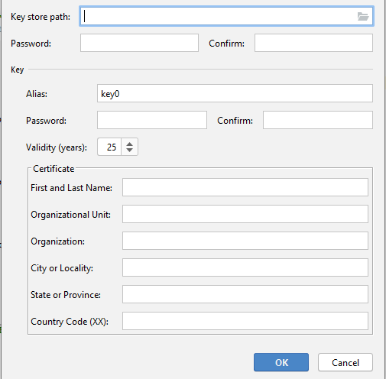
Creating new key store

Slide 7
Configuring your application for release
Remove Log calls and remove the android:debuggable attribute from your manifest file. You should also provide values for the android:versionCode and android:versionName attributes, which are located in the <manifest> element. You may also have to configure several other settings to meet Google Play requirements or accommodate whatever method you're using to release your application.
If you are using Gradle build files, you can use the release build type to set your build settings for the published version of your app.

Slide 8
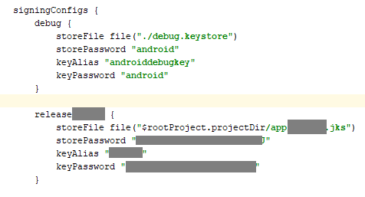
Setup gradle for automatic release signing

Slide 9
Steps to release you first app
Sign In with you google account.
Create paid developer account (price is 25$) (If you didn’t do this before)
Fill required fields
Prepare signed release with Android Studio
Upload application.
Enjoy with your users and reviews :)

Slide 10
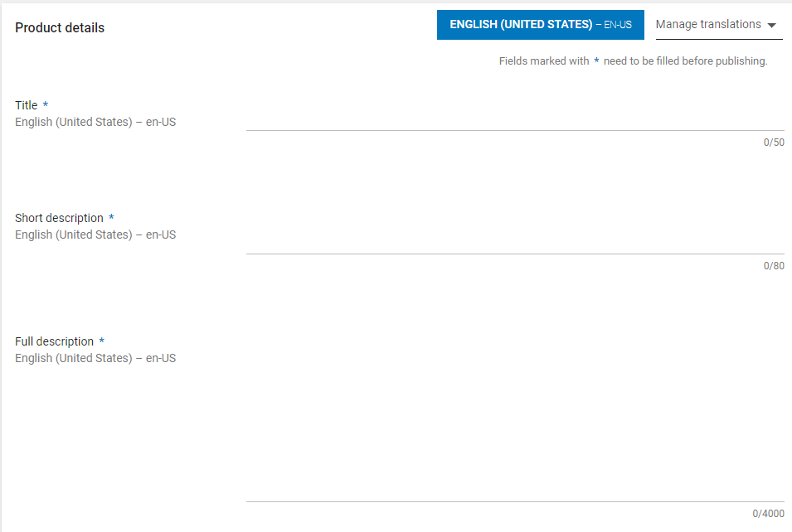
Requirements for your first release
App description and name:

Slide 11
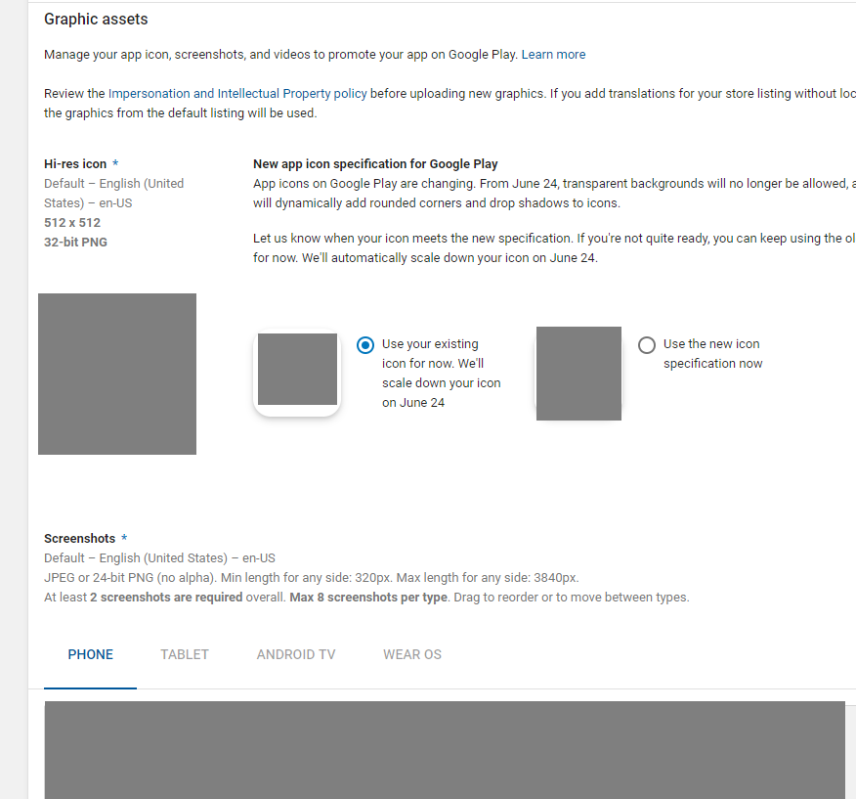
Requirements for your first release
Icons and screenshots

Slide 12
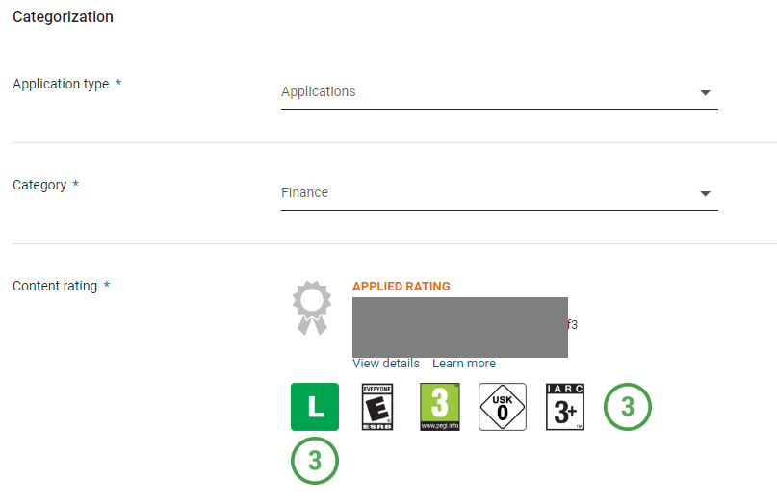
Requirements for your first release
Content rating

Slide 13
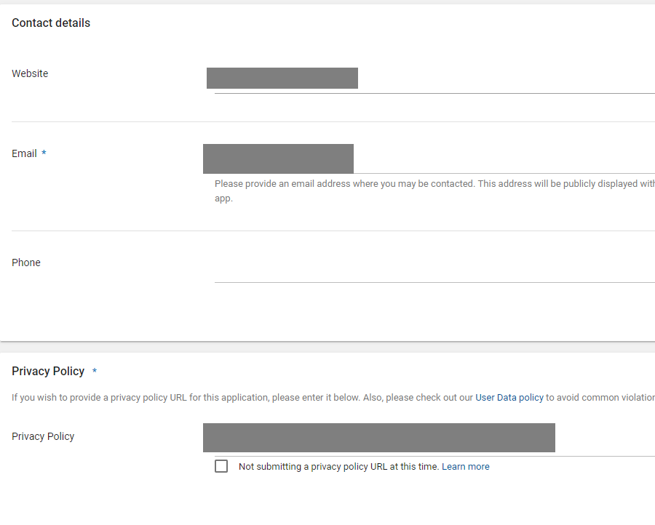
Requirements for your first release
Privacy policy, website and contact email

Slide 14
Main requirements for your app
Fill up your REAL information about developer and company.
Prepare privacy policy URL for you product.
Choose correct app category.
Fill up content rating for your application (it’s just a questionnaire about your app features).
If you need some dangerous permissions (like read SMS, read contacts) - you should provide correct credentials for Google Play app testers.

Slide 15
What is a Bundle?
Bundle is a file with “.aab” extension. It contains an instructions how to build “.apk” files with different configurations,like screen densities and processors architecture. For optimize app size for users on Play Market - you should use this format, and Play Market will prepare separated apk files for each configuration combinations (like xhdpi and armv7).

Slide 16
Releasing your application through email
The easiest and quickest way to release your application is to send it to a user through email. To do this, you prepare your application for release and then attach it to an email and send it to a user. When the user opens your email message on their Android-powered device the Android system will recognize the APK and display an Install Now button in the email message.

Slide 17
Releasing through a website
If you do not want to release your app on a marketplace like Google Play, you can make the app available for download on your own website or server, including on a private or enterprise server. To do this, you must first prepare your application for release in the normal way.
When users browse to the download link from their Android-powered devices, the file is downloaded and Android system automatically starts installing it on the device. However, the installation process will start automatically only if the user has configured their Settings to allow the installation of apps from unknown sources.

Slide 18

Thank you!

